Slide 1
SI 671/721 Discussion 1
Introduction to Machine Learning
with scikit-learn

Slide 2
Content
Machine Learning
Definition
Preprocessing
Model selection
Model evaluation
Sklearn

Slide 3
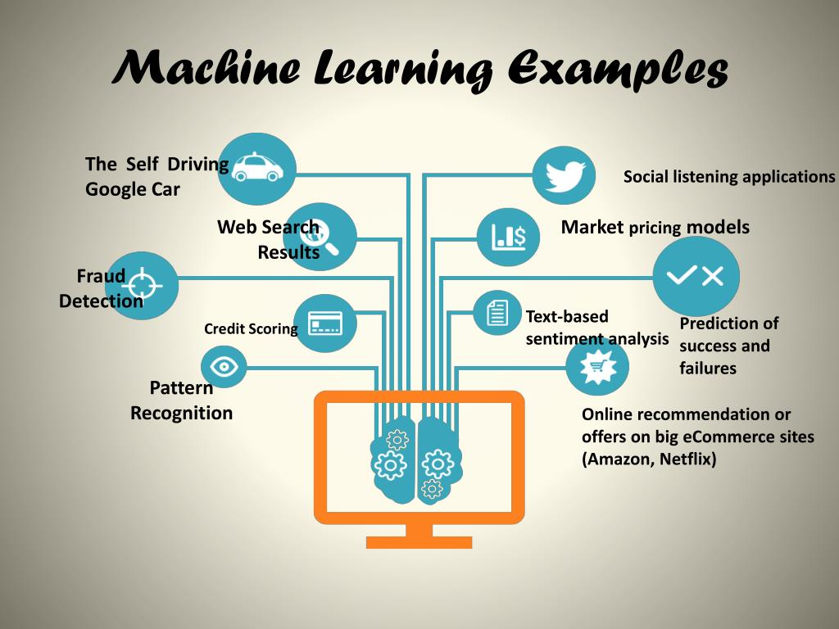
What is Machine Learning?

Slide 4
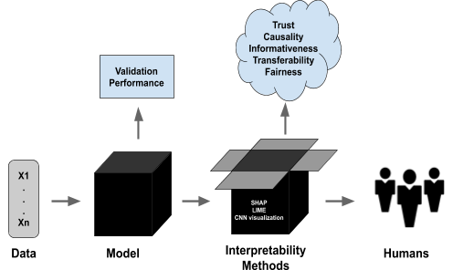
What is Machine Learning?
It focuses on enabling computers to learn from data and improve their performance on a specific task over time, without being explicitly programmed for that task.

Slide 5
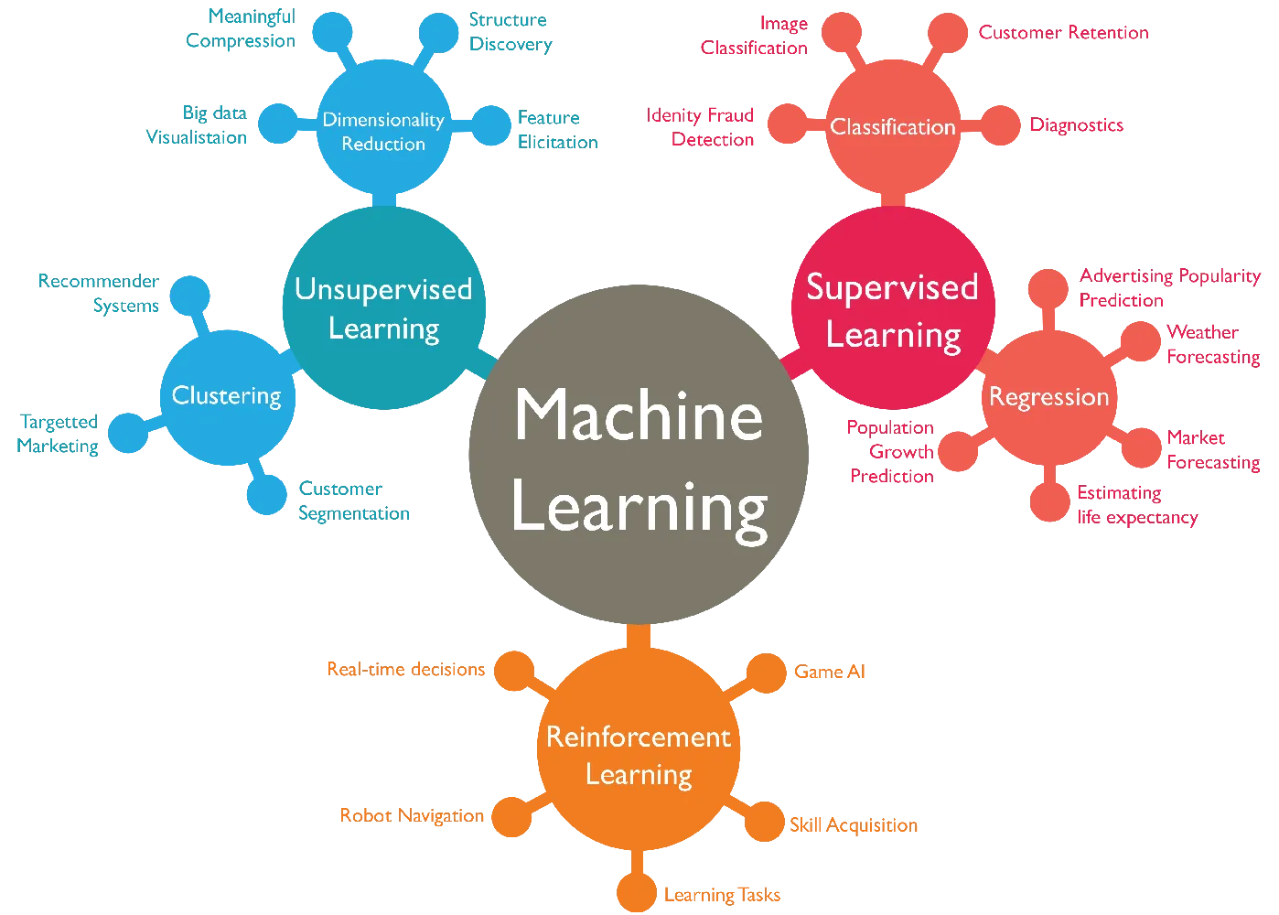
[1] Machine Learning Algorithms In Layman’s Terms.
https://towardsdatascience.com/machine-learning-algorithms-in-laymans-terms-part-1-d0368d769a7b.
Notes:
Focus on supervised and unsupervised learning

Slide 6
What is Machine Learning?
Supervised Learning vs. Unsupervised Learning:
Unsupervised learning is a category of machine learning in which models derive insights from unlabeled data without explicit feedback or direction. Unlike supervised learning, which relies on labeled data for training, unsupervised learning algorithms independently uncover data structures and patterns without predefined guidelines or information.
Notes:
Focus on applied machine learning

Slide 7
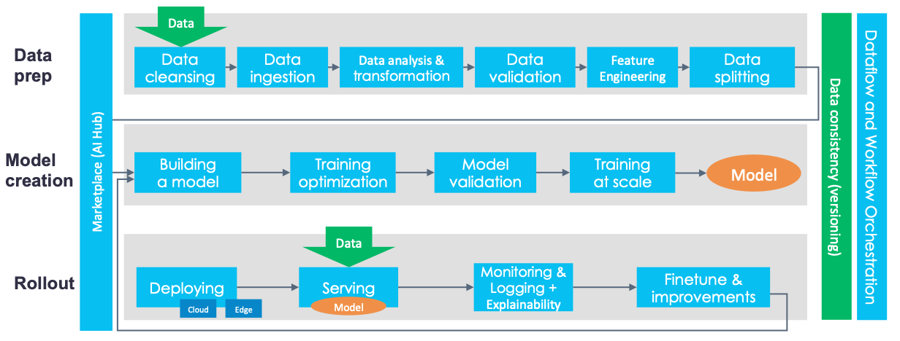
Machine Learning
An end-to-end machine learning platform is an architecture that embraces technologies designed to speed up modelling, automate the deployment, and ensure scalability and reliability in production.
[2] A Tour of End-to-End Machine Learning Platforms. https://www.kdnuggets.com/2020/07/tour-end-to-end-machine-learning-platforms.html.
Notes:
Validate the paradigm/model with small datasets and then with large ones.

Slide 8

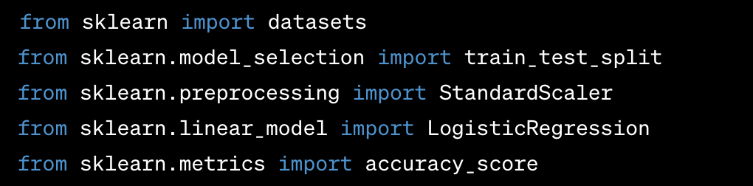
Sklearn
scikit-learn is a popular machine learning library in Python that provides a wide range of tools for data preprocessing, feature selection, model training, and evaluation.
[3] scikit-learn: machine learning in Python. https://scikit-learn.org/stable/index.html.

Slide 9
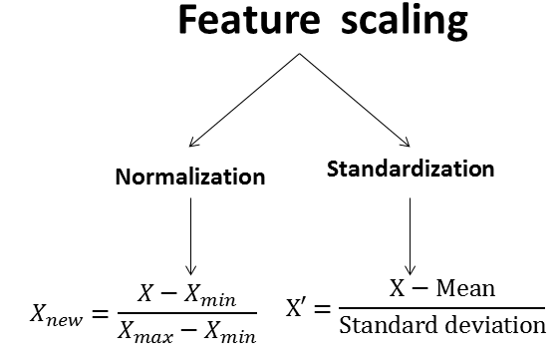
Coding with Sklearn
Missing data:
https://scikit-learn.org/stable/modules/impute.html
deletion or filling
Training and testing data
One-hot encoding
Data transformation
Feature scaling:
Normalization
Standardization
Feature selection:
Mutual information (informative)
PCA (variance)
Notes:
Normalization: scale features to a specific range
Standardization: scale it to a normal distribution
Standardization is less influenced by outliers, while normalization is often suitable when a bounded range is known.
The Mutual Information score expresses the extent to which observed frequency of co-occurrence differs from what we would expect (statistically speaking). In statistically pure terms this is a measure of the strength of association between words x and y.

Slide 10
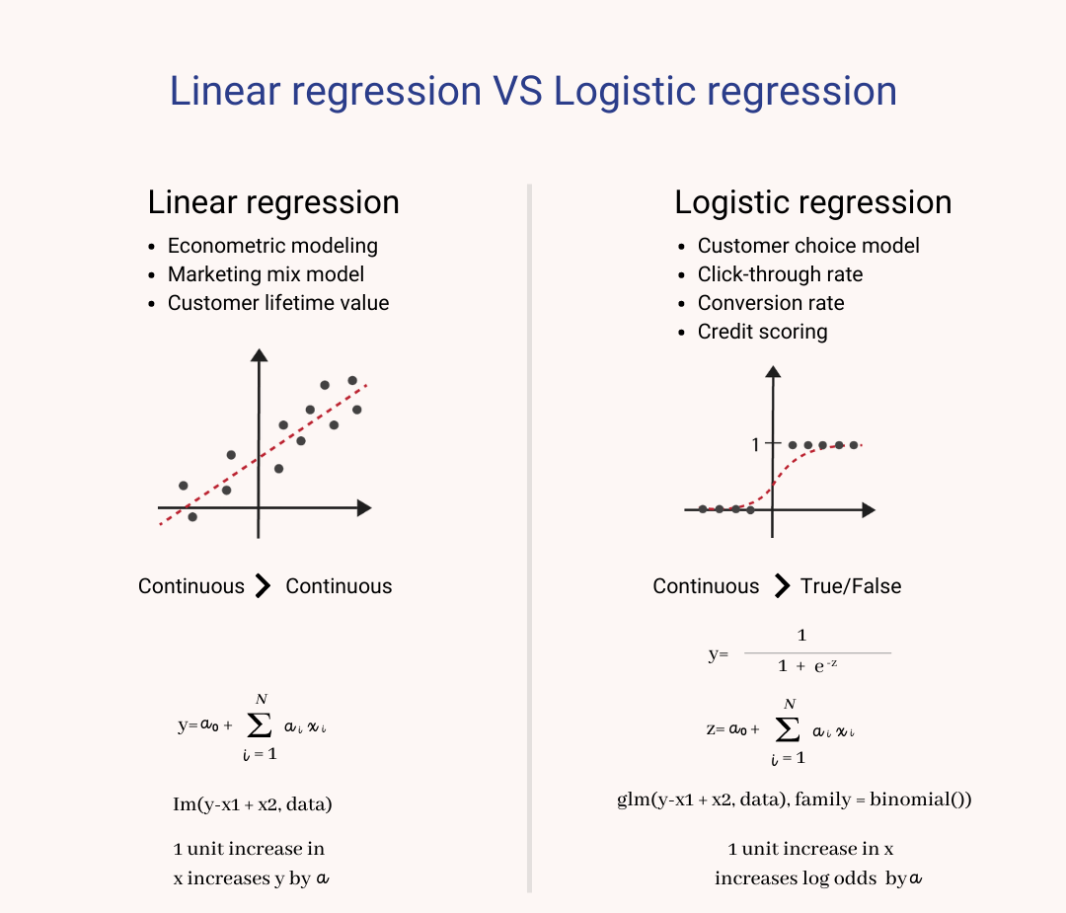
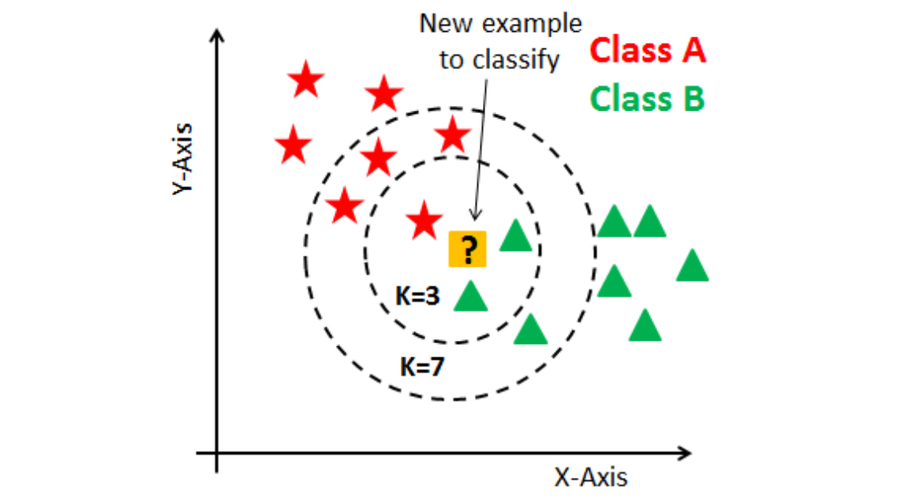
Model Selection
Linear regression
Logistic regression
K-nearest neighbor

Slide 11
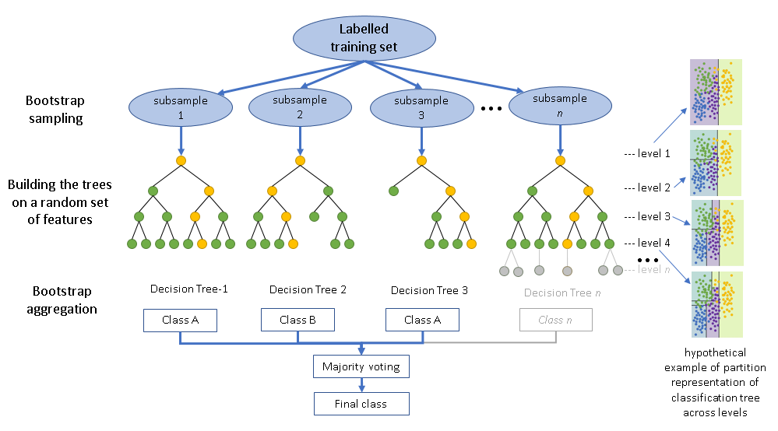
Model Selection
[4] Random forest is an ensemble learning method for classification, regression, and other tasks that operates by constructing a multitude of decision trees at training time.

Slide 12
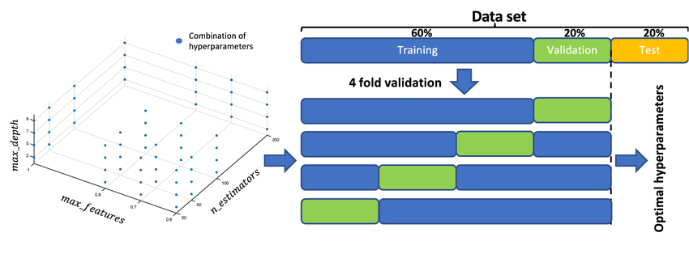
Cross Validation & Grid Search
Notes:
find the best combination of hyper-parameters

Slide 13
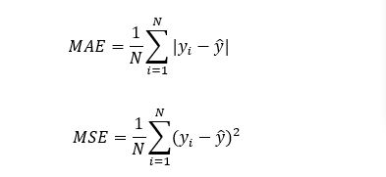
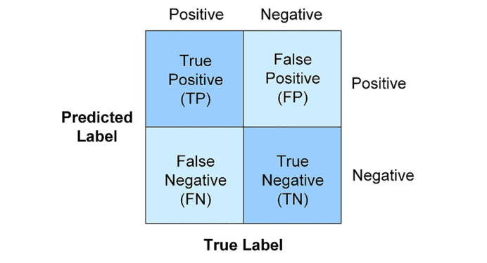
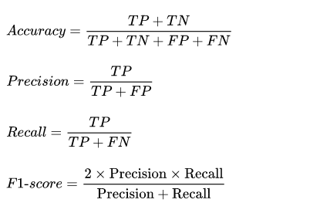
Model Evaluation
Mean square error
Mean average error
F1 score

